Slide 1
Tumor research based on single-cell sequencing technologies
Hongjin Wu
Cancer Research Lab, Hangzhou Cancer Hospital
03.15.2015

Slide 2
Content
Why single cell-seq? (Tumor/Cell Heterogeneity )
What for single cell-seq?
Single cell platform:
Genomics; Transcriptomes (MicroRNA); Epigenomics;
Tumor research with Single Cell DNA-seq
Tumor research with Single Cell RNA-seq
Single cell new platform

Slide 3
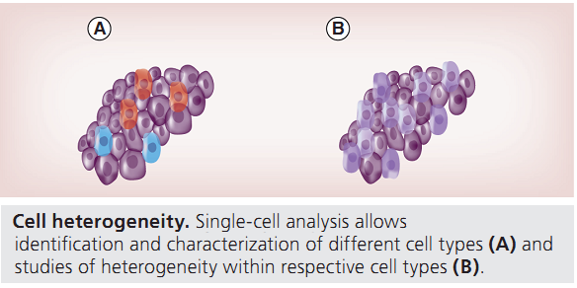
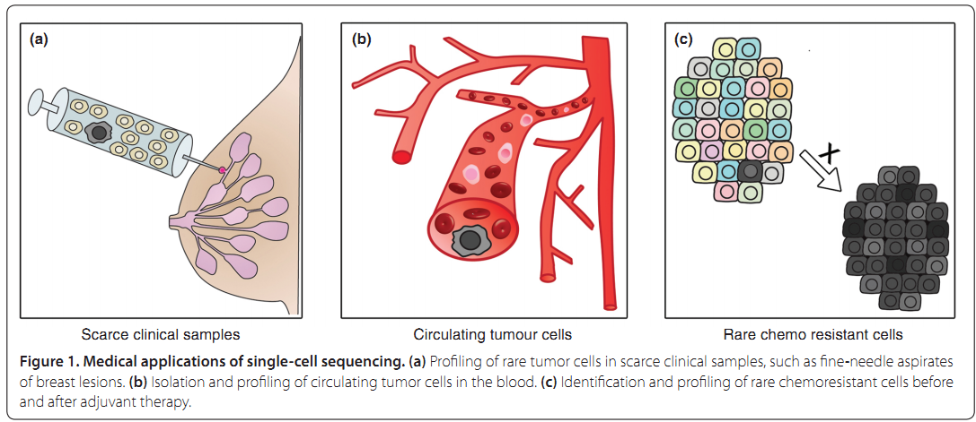
1. Tumor/Cell Heterogeneity
rare cell

Slide 4
2. Single Cell Platform
Single-cell genomics: MDA Amplification
Reconstructing cell lineage trees using somatic mutations.
Single-cell transcriptomics: SMART-seq2 / CEL-seq
Supplant the coarse notion of marker-based cell types.
Single-cell epigenomics and proteomics: BS/RRBS/??
Allow the functional states of individual cells to be analyzed.

Slide 5
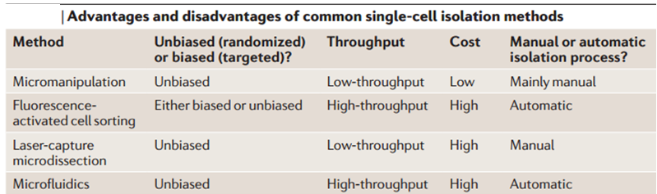
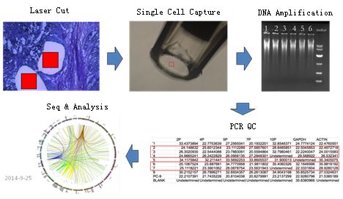
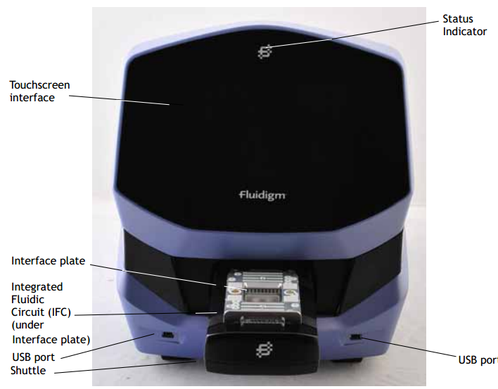
Current technologies for Single-cell isolation

Slide 6
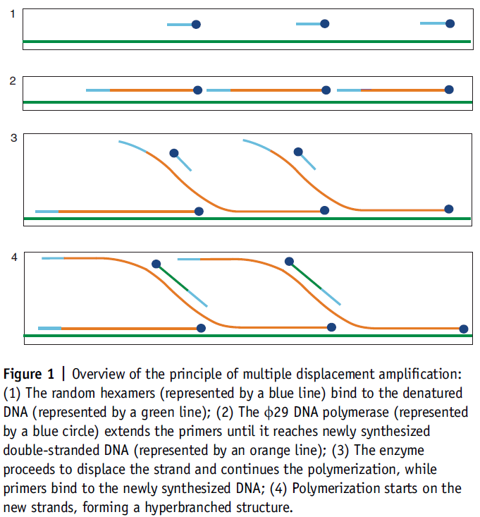
3. Single Cell Genomics
Reconstructing cell lineage trees using somatic mutations.
Cell lineage reconstruction of cancer will elucidate its development.
----------------------------------------
MDA (Multiple displacement Amplification)
MALBAC (Multiple Annealing and Looping Based Amplification Cycles)
----------------------------------------
WGS / Exon-seq / Target region-seq
----------------------------------------
Hiseq 2000/2500 …

Slide 7
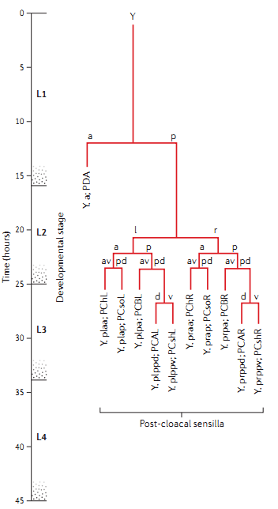
Reconstructing cell lineage trees using somatic mutations
Whole-organism science: the Caenorhabditis elegans benchmark and the principle of biological uncertainty.

Slide 8
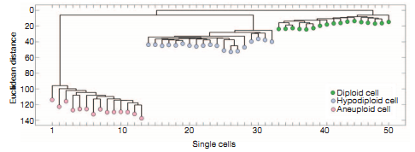
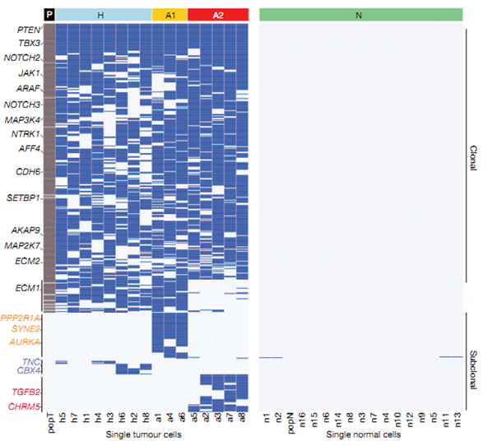
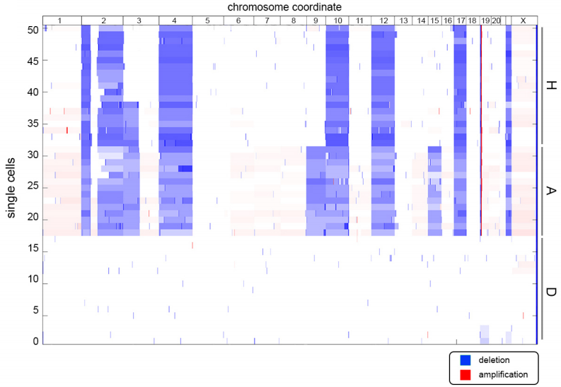
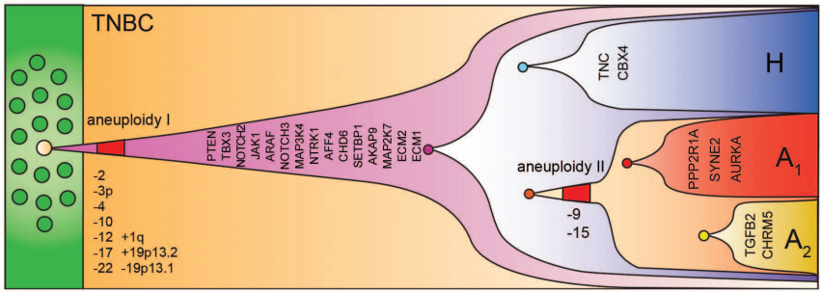
Clustered heatmap of the nonsynonymous point mutations detected by single nuclei exome sequencing and population sequencing
CNV
SNV
Single cell and population sequencing of a triple negative breast cancer (ER⁻/PR⁻/Her2⁻).
YongWang, et al. Nature, 512, 155-160. (2014)

Slide 9
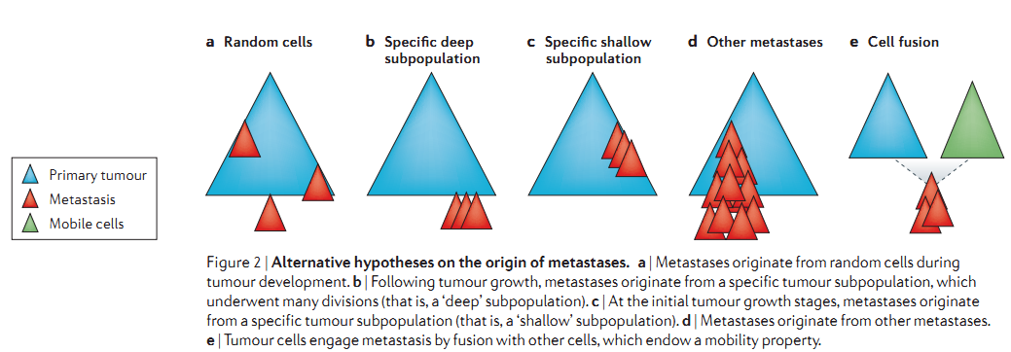
Cell lineage reconstruction of cancer will elucidate its development
Cancer & Metastasis: where metastases originate from?
a. Metastases originate from any tumour cell.
b/c. Metastases originate only from a distinct tumour subclone (for example, CTC).
d. Metastases and the primary tumour are both independent descendants of cancer stem cells.
e. Metastases are formed through the fusion of primary tumour cells and normal mobile cells such as macrophages.
Ehud Shapiro, et al. Nature Reviews Genetics, 30, (2013)

Slide 10
Cell lineage reconstruction of cancer will elucidate its development
Cancer & relapse after Radio/Chemotherapy.
Caused by ordinary tumour cells escaping Radio/Chemo-therapy stochastically.
Caused by a distinct subpopulation of infrequently dividing cancer initiating cells that escape Radio/Chemotherapy owing to their slow division rate. (Combined with RNA/ Methylation analysis)

Slide 11
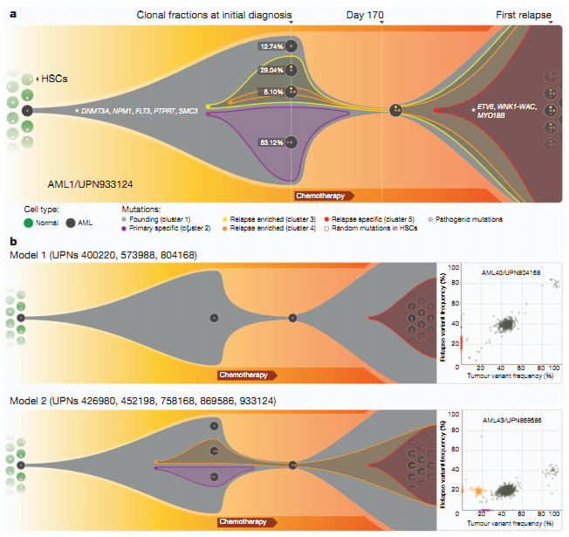
a. Graphical representation of clonal evolution from the primary tumour to relapse in UPN 933124,
b. Patterns of tumour evolution observed in eight primary tumour and relapse pairs.
Li Ding, et al. Nature, 418, 506-510 (2012)

Slide 12
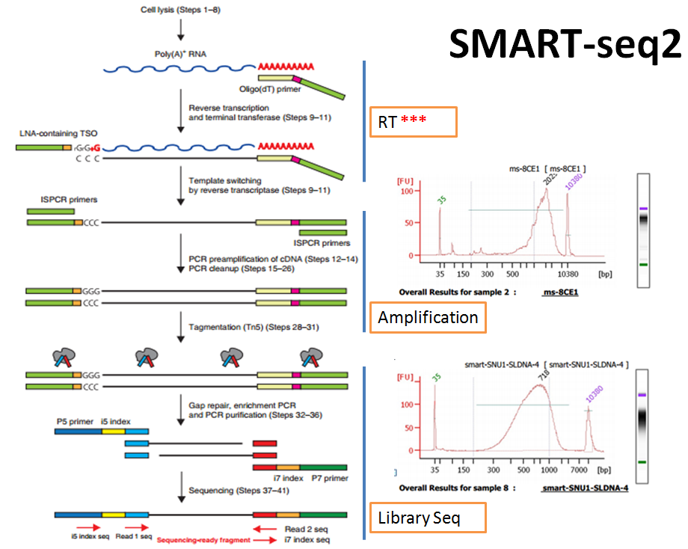
4. Single Cell Transcriptomes
Definition of Cell Types.
----------------------------------------
SMART-seq2 (Switch Mechanism At the 5’ end of Reverse Transcript)
CEL-seq (Single-Cell RNA-Seq by Multiplexed Linear Amplification)
----------------------------------------
Hiseq 2000/2500

Slide 13
Single Cell Transcriptomes
Analysis of rare cell types
(CTC, circulating tumour cells; early human embryo; adult stem cells;)
Definition of Cell Types (with cell transcriptome)
Individual cells differ greatly in their size, morphology, developmental origin and functional properties.
Our current level of understanding of cell types, their origin, evolution and diversity is embarrassingly poor.
Characterization of transcriptional fluctuations

Slide 14
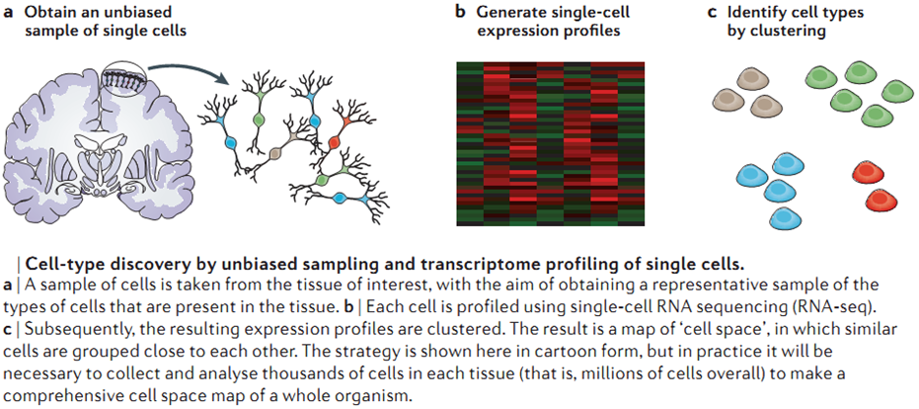
Definition of Cell Types
BGI & Ruijin Hospital,
Human/mouse pancreas islet cell types classification and Diabetes.
Ehud Shapiro, et al. Nature Reviews Genetics, 30, (2013)

Slide 15
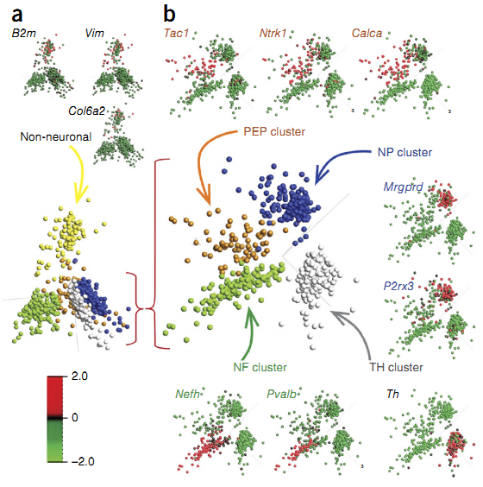
Definition of Cell Types
Single-cell RNA-seq of DRG cells reveals cellular heterogeneity.
(a) Bottom: PCA of single-cell gene expression patterns for 799 individual cells assigned 731 of them to five clusters, one of which contained non-neuronal cells. Insets (top) show the same PCA plot with cells colored according to relative expression of representative genes mapped back to non-neuronal cells.
(b) PCA of 622 neuronal cells comprising the four principal neuronal types. Insets show the same PCA plot with cells colored according to relative expression of representative genes mapped back to the different populations.
Group identity was defined as peptidergic nociceptors (PEP), non-peptidergic nociceptors (NP), neurofilament containing (NF) and tyrosine hydroxylase containing (TH). Tac1 encodes substance P; Ntrk1, TRKA; Calca, CGRP; Mrgprd, MGRPRD; P2rx3, P2X3; Nefh, neurofilament heavy chain; Pvalb, parvalbumin; Th, tyrosine hydroxylase. Color key represents normalized gene expression with mean 0 and variance 1.
Dmitry Usoskin, et al. nature neuroscience, 2014

Slide 16
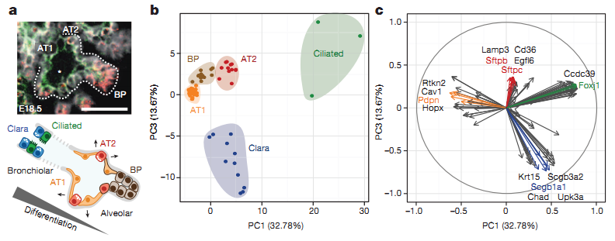
Definition of Cell Types
Single-cell RNA-seq of 80 embryonic (E18.5) mouse lung epithelial cells enables unbiased identification of alveolar, bronchiolar and progenitor cell populations.
a, Spatially heterogeneous differentiation of distal lung epithelium.
b, PCA of 80 single-cell transcriptomes (three biological replicates) at E18.5 distinguishes between major bronchiolar and alveolar cell lineages. PC, principal component.
c, Distinct gene groups characterize each cell population on the basis of differential correlation with PC1 and PC3.
Barbara Treutlein, et al. nature, 2014

Slide 17
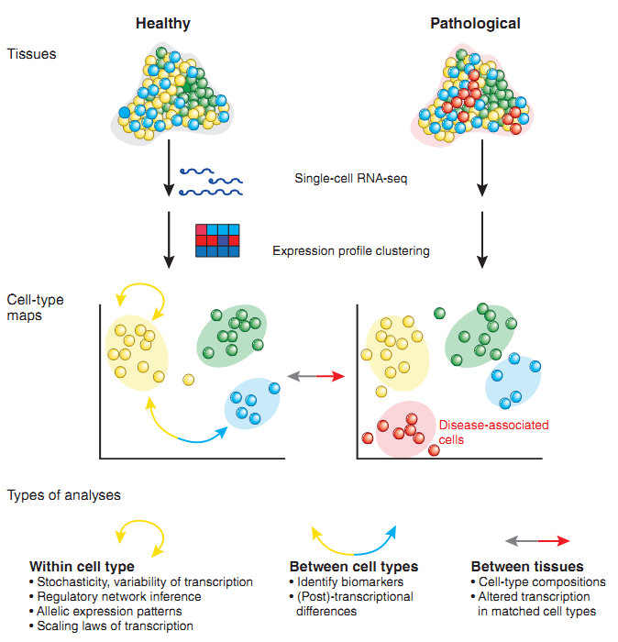
Single-cell transcriptome analyses of tissues and cell types.
Cells from a healthy or pathological tissue are dissociated, analyzed independently with single-cell RNA-seq and clustered based on their gene expression profiles.
Clustering of cells reveals a cell-type map that can be used to assess the composition of the tissue including the identification of new cell types or subtypes.
These rich data can be used to address many questions of gene expression and regulation within or between cell types and between tissues.
Rickard Sandberg, Nature methods, 11, 22-24, (2014)

Slide 18
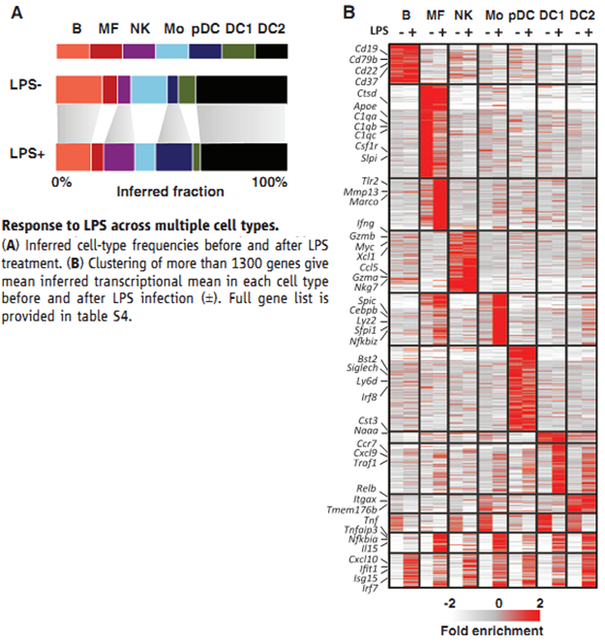
Multiple cell type response to Drug treatment.
Using the non-LPS mixture model, we classified the non-LPS and LPS-exposed
cells into classes and inferred a rich transcriptional profile within each class before and after treatment.
Clustering 1575 variable genes identified groups of cell type–specific response genes.
(such as Tnf and Marco in macrophages and Xcl1 and Gzmb in NK cells)
a large group of type I interferon response genes (Irf7, Stat2, Ifit1, Cxcl10, and hundreds more) activated pervasively in all or almost all cell types.
Diego Adhemar Jaitin, science, 343, 776-779, (2014)

Slide 19
Limitation of current single cell RNA-seq
Limitation of all RNA-seq approach:
Similar detection limits (5–10 molecules of mRNA).
Quantitative biases due to amplification, limitation to poly-adenylated RNAs, and gene-specific biases due to GC content or secondary structure.
Currently, RNA needs to be converted to cDNA and amplified.
Several sources of noise in a single-cell transcriptome experiment:
1. Biological fluctuations: both global (that is, affecting the total amount of RNA in the cell) and local (for example due to co-regulation or large-scale chromatin modifications).
2. Technical noise: pipetting errors; temperature differences; differences in sequencing depth; PCR amplification bias and differences in reverse transcription efficiency.

Slide 20
5. Single Cell New Platform
Single cell Transcriptomes
Single cell RNA-seq (single molecular counting);
Single cell MicroRNA/LncRNA;
Single cell epigenomics
Single cell RRBS;
Whole genome epigenomics;
Single Cell - seq
DNA-seq
+
RNA-seq

Slide 21
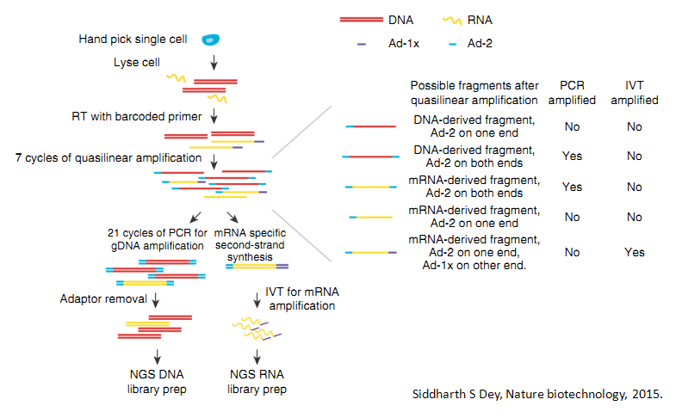
Single Cell-seq
Single Cell - seq
DNA-seq
+
RNA-seq
DNA
MDA (DNA-seq) / BS, RRBS
Cell
RNA
RNA-seq (SMART-seq2)
Single cell seq:
One single cell, sequence both DNA and RNA.

Slide 22

Our Team
Prof. Shixiu Wu.
PHD Zhaoyang Hu.

Slide 23
That’s ALL. Thanks for Listening!

